Slide 1
Peers as Allies
Teaching and Learning Resources
to Prevent Identity-based Bullying
LESSON FOUR:

Slide 2
Land Acknowledgement

Slide 3
What is Bullying?
Destructive relationship
Power imbalance
Repeatedly aggressive with intent to harm
Notes:
In Canada, at least 1 in 3 teens report being bullied. When we say bullying, we are talking about [CLICK] a destructive relationship [CLICK] where one person or a group of people holds power over another, and [CLICK] intentionally acts aggressively to harm them. This is often done repeatedly. Bullying can happen in person or online.
Someone has power [CLICK] when they have the ability to act in ways that can impact the lives of others, either positively or negatively. Power is related to things like social status and popularity. Youth bully others in order to gain power. Today, we’ll be talking more about the power dynamics that help us understand bullying.

Slide 4
Identity-Based Bullying
Bullying that targets people based on their identities.
Gender
Sexual orientation
Race
Ethnicity
Nationality
Body size
Class
Disability
Notes:
Identity-based bullying targets people based on their identities. People’s identities include many things, [CLICK] such as body size, race, ethnicity, citizenship status, gender, sexual orientation, class, and ability, among others. Identity-based bullying means repeatedly targeting someone because of these identities, for example by calling someone hurtful names because they are gay, excluding someone because they are of a different race, catcalling someone because they’re a girl, making a hurtful social media post about someone based on their physical appearance, or making fun of someone because they are in a wheelchair.

Slide 5
Identity-based Bullying
Power imbalance
Power = ability to impact lives of others
Created by society
Notes:
Bullying happens when there is a difference in power between people. Someone has power when they have the ability to act in ways that can impact the lives of others.
The differences in power that are at the root of identity-based bullying have been created by society, by oppressing some groups and privileging others over time. Because of this, some groups in society continue to have more power as compared to others (for example, heterosexual youth hold more social power than queer youth).

Slide 6
Impacts for Youth Who Are Bullied
Physical
challenges
Mental health
challenges
Academic
challenges
Social
challenges
Notes:
Youth who are bullied are more likely to experience mental, physical, academic, and social challenges.

Slide 7
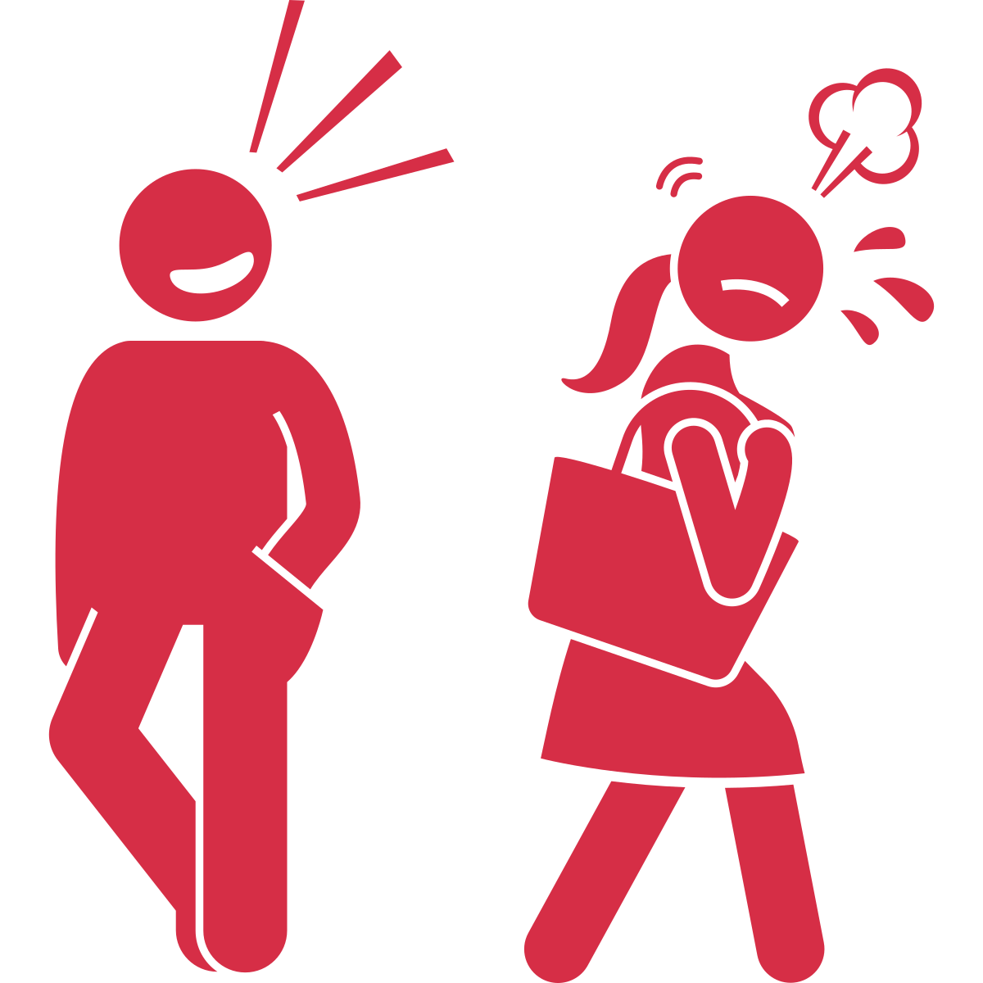
Impacts for Youth Who Are Bullied
Dating violence
Sexual harassment
Notes:
They are also more likely to experience other types of harm later in life, like [CLICK] dating violence or[CLICK] sexual harassment, compared to people who are not bullied.
Facilitation guidance: The content from the beginning of the video until now has already been covered in videos 1 – 3. If you feel you and your students are familiar with this information, you do not need to repeat it all. However, if you feel your students need a refresher, you can remind them of this information. Alternatively, you can present the information in a more engaging way, by asking students to define the terms. For example, “Previously we talked about identity-based bullying. Does anyone remember what that term refers to?”

Slide 8
Identity-Based Bullying
Notes:
This video focuses on identity-based bullying, specifically. Although many youth in Canada experience identity-based bullying, [CLICK] most youth say it is not right and identify it as morally wrong. What’s more, most youth say [CLICK] they are willing to intervene in some way to stop bullying. Youth are more likely to intervene if they have a relationship with the person being bullied, if they want to help, if they want to make a difference, and if they feel that stopping bullying is everyone’s responsibility.

Slide 9
Youth Do Not Often Intervene
Notes:
However, even though many youth are willing, youth still do not intervene very often. Why is that?
Facilitation guidance: At this point, you may want to stop and ask your students about barriers to intervening might exist in your school. For example, fear of retaliation, feeling it was not their business, not wanting to get into trouble, feeling no one would do anything if they reported it, feeling as if it would not make a difference, and not wanting to get involved.
Well, there are are certain things that make it difficult for youth to speak up and stop bullying. Today we’re going to talk about what makes it hard for many youth to take a stand against bullying, and what we as educators can do about it.

Slide 10
The 5 Steps to Intervening
1
Notice the event.
2
Consider it an emergency.
3
Take responsibility.
4
Know how to help.
5
Take action.
Notes:
There are 5 steps youth can take to intervene in identity-based bullying.
First, youth need to notice the event. That means they have to be able to identify identity-based bullying. Second, they have to interpret it as an event where someone needs help from others. After that, they need to feel responsible to help. Fourth, they need to know what to actually do to intervene. And then finally, they need to take action.
So first, how do we make sure youth can identify identity-based bullying? If they can’t notice the bullying, they can’t take any action to prevent it!

Slide 11
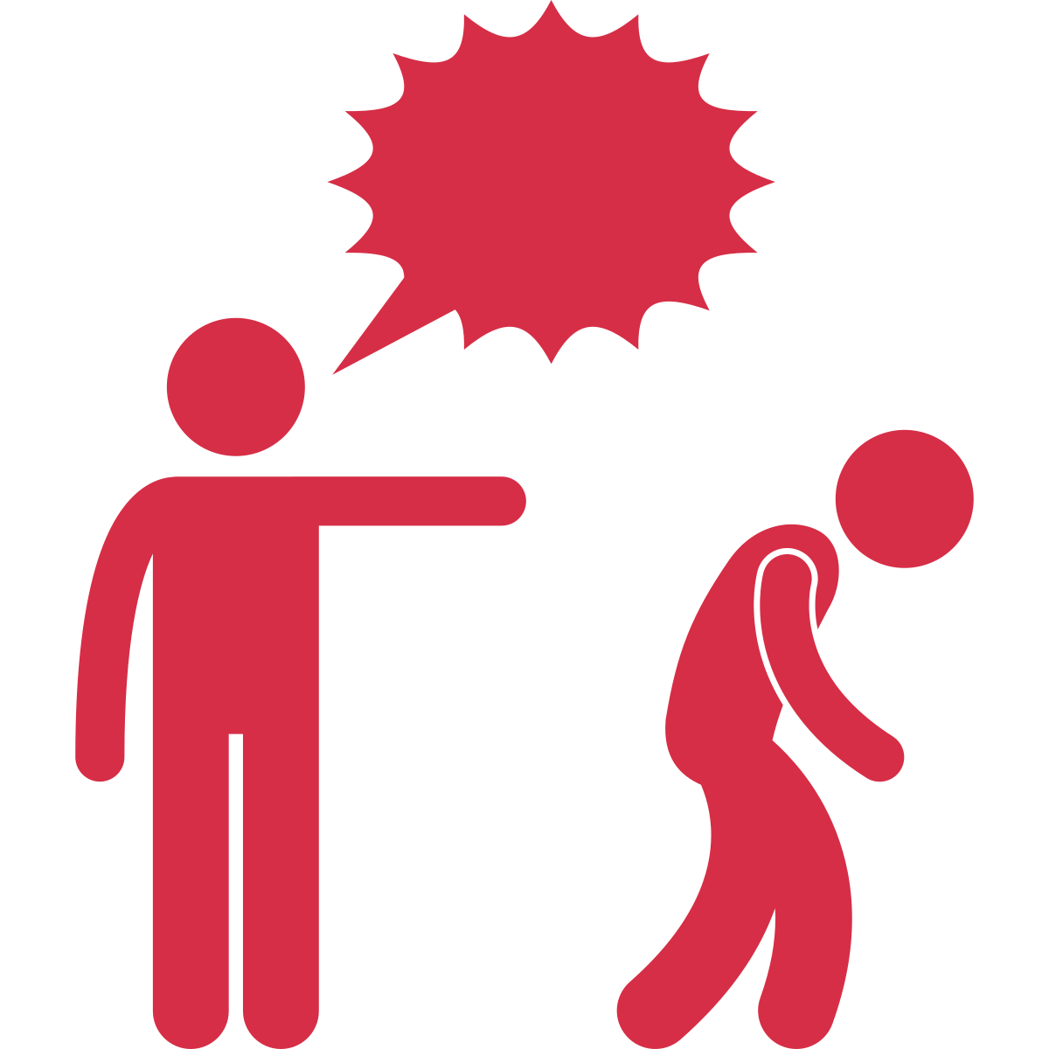
IDENTITY-BASED BULLYING OR TEASING?
Is it harmful?
Notes:
Many people (youth and educators alike) struggle to know the difference between playful teasing that happens between friends and identity-based bullying.
First, [CLICK] we must consider the content of what is being said. Even if something is said in a playful way, if the content itself is harmful to the recipient, then it’s not teasing.
If someone from a dominant group is making fun of someone from a marginalized group because of their identity with the intent to hurt them, it is always harmful.

Slide 12
IDENTITY-BASED BULLYING OR TEASING?
Is there a power difference?
Notes:
Second, think about whether a [CLICK] power differential exists. Playful teasing occurs between two friends who are equals, and it demonstrates closeness and affection between friends. On the other hand, identity-based bullying is not reciprocated.
If you see students from a group that holds less power being made fun of by students from a group that holds more power, for example because of their gender, race, ethnicity or ability, it inherently involves a power imbalance, and therefore always causes harm.

Slide 13
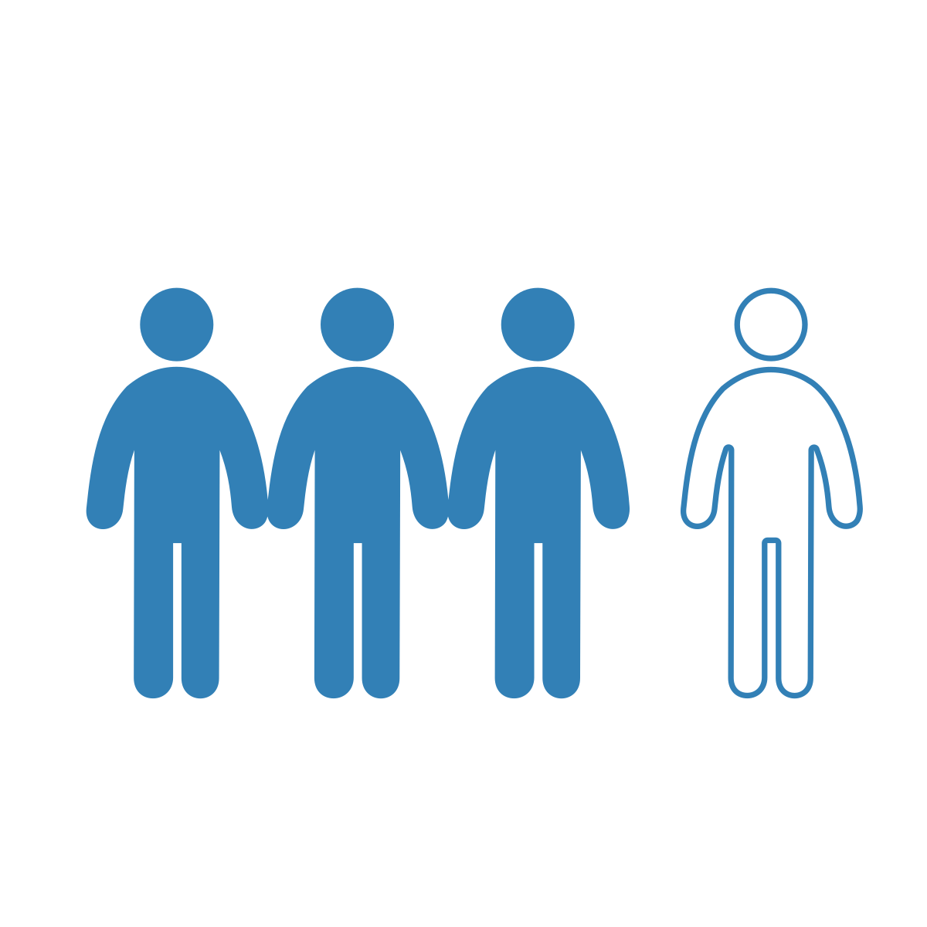
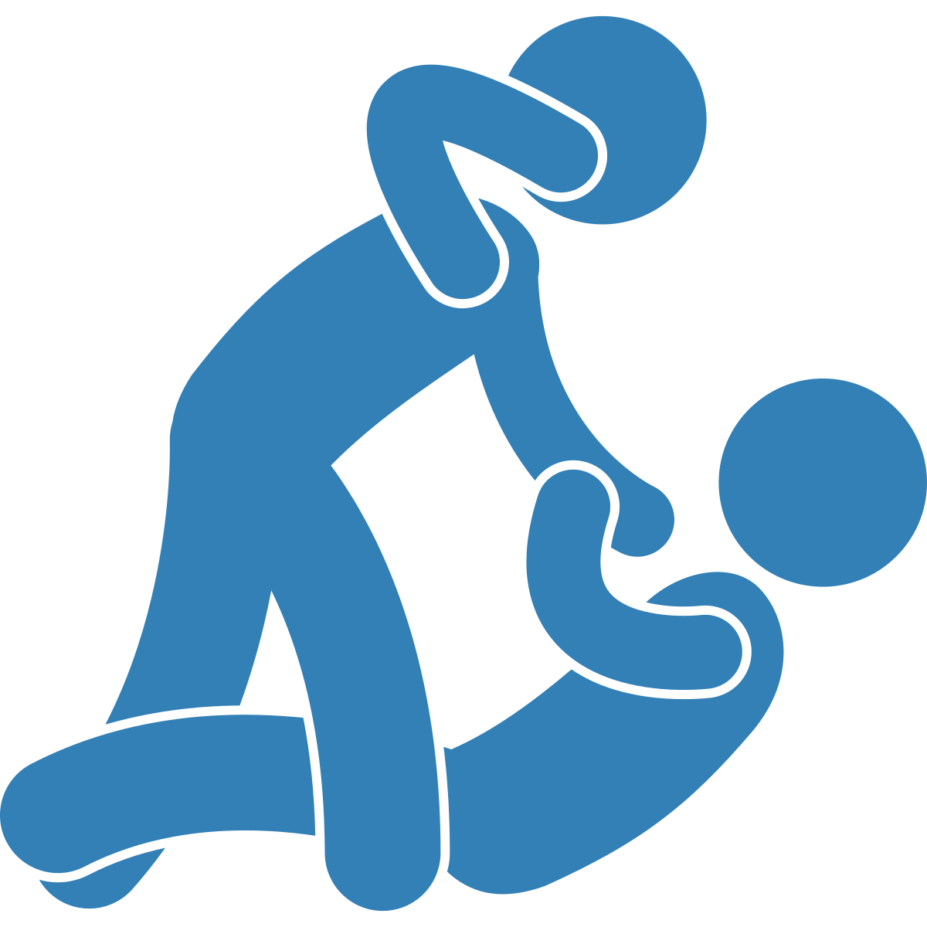
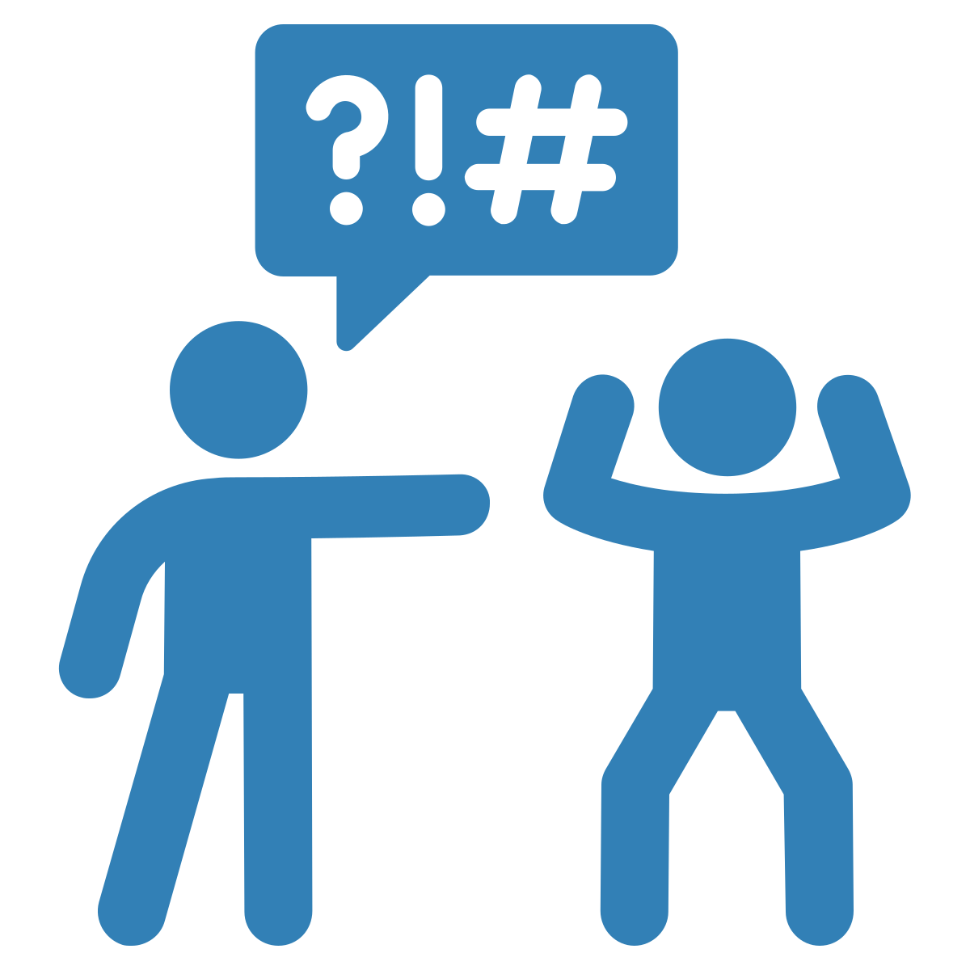
Forms of Identity-based Bullying
Notes:
In addition, it’s important to understand that identity-based bullying can take any form. It could take the form of [CLICK] physical, [CLICK] verbal, [CLICK] social, and/or [CLICK] cyber bullying. Regardless of the form, it always involves someone from a dominant group making fun of someone from a marginalized group because of their identity with the intent to hurt them. As a few examples, it could look like:
Hitting someone because they are from a marginalized ethnic background (physical)
Calling someone names because of their body size (verbal)
Excluding someone from a group because they have a disability (social), or
Making mean posts on social media about someone because they are bisexual (cyber)

Slide 14
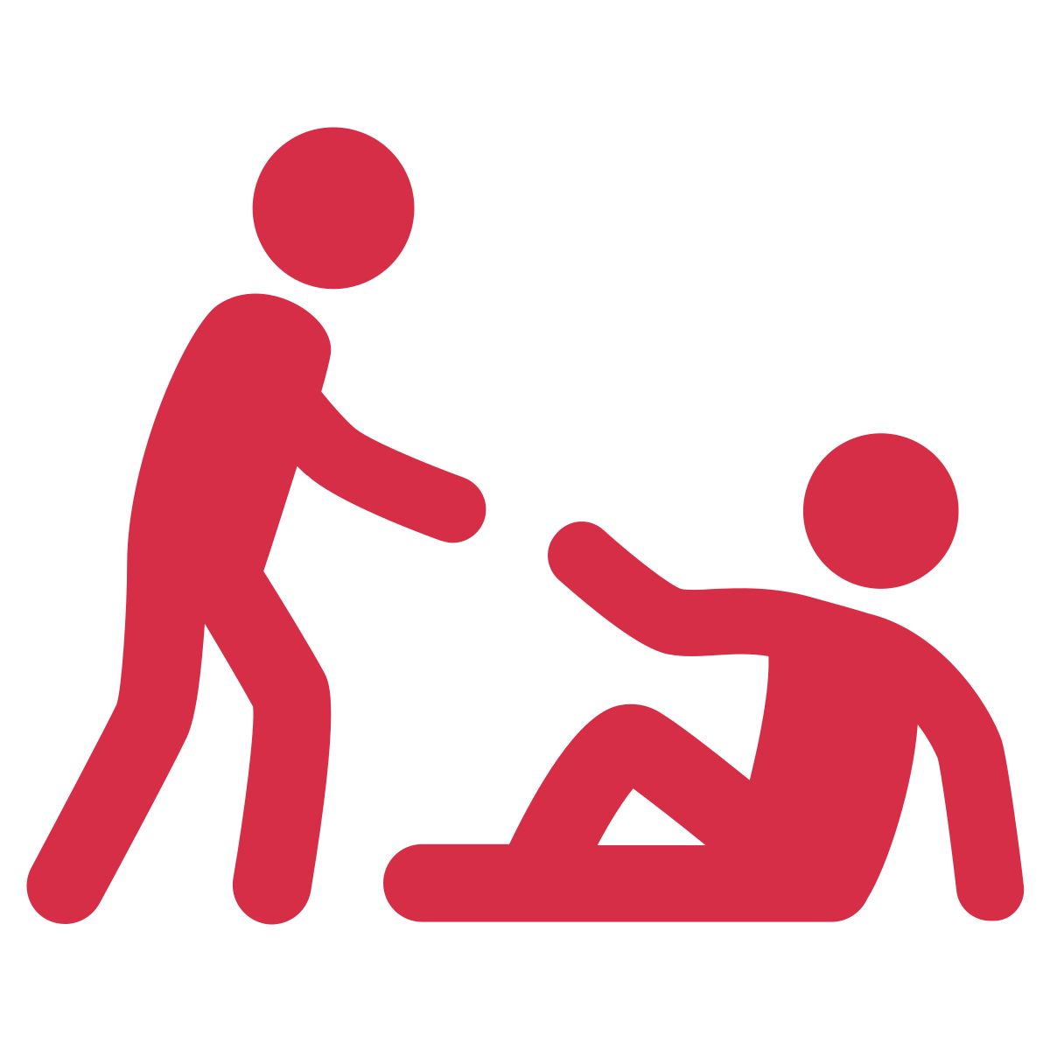
INTERPRET EVENT AS AN EMERGENCY
Notes:
Second, youth must interpret the event as an emergency. When we say an emergency, [CLICK] we mean an event where someone needs help from others.
All events of identity-based bullying should be considered an emergency. This is because identity-based bullying targets a core aspect of who someone is, making it always harmful. However, there are certain times when youth will not interpret identity-based bullying as an emergency. We need to understand why this might be, so we can help youth correct their thinking and interpret all events of identity-based bullying as emergencies

Slide 15
Notes:
For example, [CLICK] youth are more likely to intervene when they see physical bullying as compared to other types [CLICK] like verbal or social bullying.
This might be because youth tend to think physical bullying is more serious as compared to verbal or social bullying.

Slide 16
Trigger Warning: Suicide
Notes:
However, all types of identity-based bullying are serious and harmful. For example, think of the tragic case of Ottawa youth Jamie Hubley.
Jamie was a 15-year old gay boy, who was relentlessly bullied about [CLICK] figure skating and being gay. He was constantly verbally assaulted, and he felt very alone about being the only “out” gay student in his high school and feeling that no one accepted him. [CLICK] This led to an intense depression, and Hubley ultimately ended up taking his life.
This is one example of an extreme case that ended in suicide. Even though suicide is a rare outcome, this example demonstrates that all forms of identity-based bullying can be harmful.

Slide 17
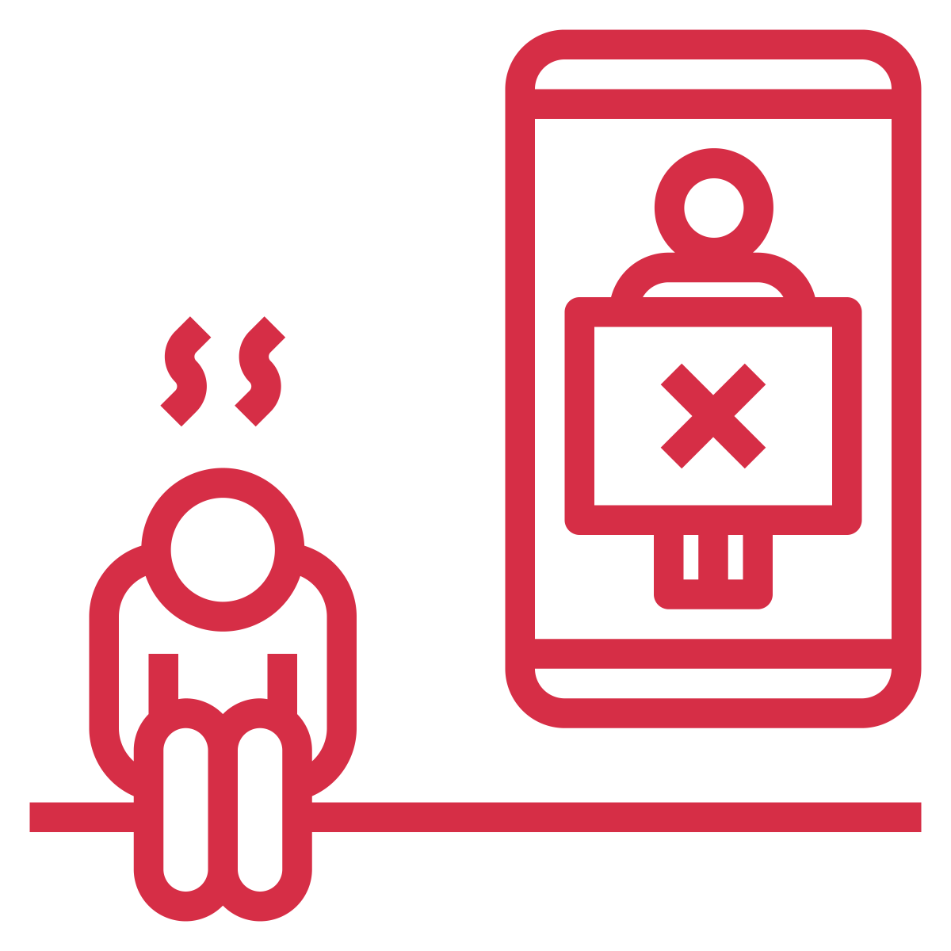
Notes:
As another example, some youth are more likely to think that when a girl does the bullying, it’s not very serious. Because of this belief, youth may be less likely to intervene when they see a girl engaging in bullying.
Consider the example of Addison [CLICK], one of the popular girls in high school who is White. She’s been creating social media videos [CLICK[ every week to call out all the boys in her class as ‘hot’ or ‘not’. When she gets to Michael, an Indigenous boy, she makes fun of his braids and says he is ‘definitely not hot – his hair is like a girl’s!”. Other classmates then comment their agreement, with one stating “Eew I know – does he even wash it?”
These comments cause Michael to feel shame about his braids. His braids are part of expressing his culture, and so he also feels shame about his culture. Michael feels very sad and like he will never be accepted and starts to disengage at school.
This is an example of identity-based bullying where a White girl (someone from a dominant group) is making fun of someone from a marginalized group because of their identity with the intent to hurt them.
It should be seen as an emergency that requires action. However, some youth will be hesitant to intervene because they also hold beliefs that when girls do the bullying, it’s not very serious.
So, the message is that all kinds of identity-based bullying are serious and harmful. Understanding this helps us and the youth we work with interpret all identity-based bullying events as emergencies.

Slide 18
Why don’t youth intervene?
1
Losing social status.
2
Fear of retaliation.
3
Experiencing distress
or negative emotions.
Notes:
After youth identify identity-based bullying and then interpret it as an emergency that needs help, they need to actually feel like it’s their responsibility to help. But what could get in the way of that?
Youth might fear personal consequences if they step in and defend the person being bullied. For example, [CLICK] someone might lose status with their peers if they challenge someone publicly who has a lot of social power and status in the school. This is a valid fear, as losing social status can be very serious for youth. So, we need to consider alternative options for some youth when losing social status is a potential repercussion.
Youth may also [CLICK] fear retaliation. Sometimes, when someone defends another person, they may then become a target for bullying. This legitimate fear can be enough to stop them from stepping in.
Also, youth who have repeatedly experienced identity-based bullying or youth who hold less social status in the school may not be in a safe place to directly intervene. For example, [CLICK] these youth may experience increased distress or negative emotions like anger and guilt if they engage in direct defending. So, we shouldn’t ask all youth to speak up and intervene directly, as there are many valid reasons for why it could end up actually harming them.

Slide 19
Peer Leaders
1
Have social power and status.
2
Have influence with their peers.
3
Can lead by example.
Notes:
However, there are some students we can ask to speak up and directly intervene. In fact, [CLICK] it’s actually youth who hold power and status in the school that are in the best positions to speak up when they see identity-based bullying. So, we should encourage peer leaders to speak up against comments that are racist, homophobic, ableist, etc. In addition, they can be vocal about valuing everyone, for example by saying things like “It’s ok to be whoever you want to be”.
Students with social power also have a lot of say over the norms of the peer group. [CLICK] High status youth have a lot of influence of their peers. So, if powerful and high-status youth intervene when they see identity-based bullying, their peers will also be more likely to intervene. Thus, powerful and high-status youth in the schools can act as peer leaders [CLICK], being the ones to send a powerful message that identity-based bullying is not ok.
Facilitation guidance: See “Strategies to Help Students to Become Allies and Prevent Identity-Based Bullying” below (end of script) for specific ways to help peer leaders build their capacities to stand up against identity-based bullying.

Slide 20
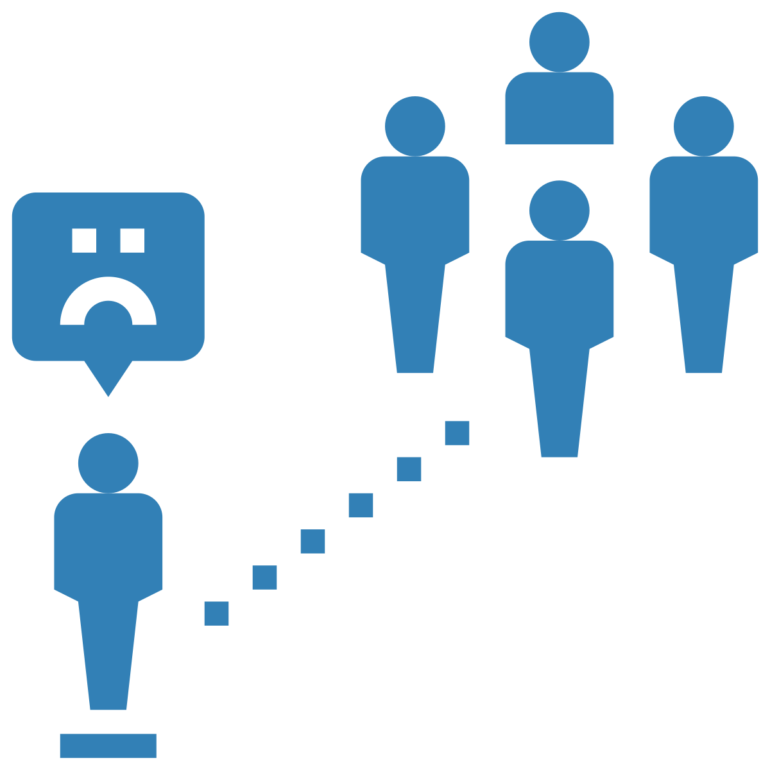
Why don’t youth intervene?
Notes:
In addition, many youth may have thoughts like “there are so many other people who see this happening, and those people probably know the person being bullied more than I do…[CLICK] so I’m sure someone else will do something about it”. When this happens, we call it the bystander effect, or the belief that because so many other people are around, someone else will surely do something to help. Unfortunately, this is rarely the case. As more people observe the event, the likelihood of someone intervening goes down. So, we need to tell youth about the bystander effect so they can change this tendency to believe someone else will step in. We can instead encourage them to do something, on their own or with their peers, even if they see others witnessing the identity-based bullying.
Taken together, all of these things can make it hard to step in and defend the person being bullied. Because defending is challenging to do and tied to things like someone’s own popularity, status, and power, not all youth are in a position to defend others directly.
Facilitation guidance: Many youth have been socialized to “stay out of other people’s business”. So, when we talk to students about ways to be allies (including ways to directly intervene), it can feel counterintuitive. Be prepared to have conversations about how there is a difference between “being nosy/getting into other people’s business” and “being an ally”.
Remember that the message we are sending is this: everyone has the right to be respected and safe, and that we have a collective responsibility to be inclusive and act as allies for people who experience identity-based bullying. There are many ways to act as an ally, and we only suggest that students intervene if they feel safe to do so, and if they have a way to intervene in a way that keeps everyone safe.

Slide 21
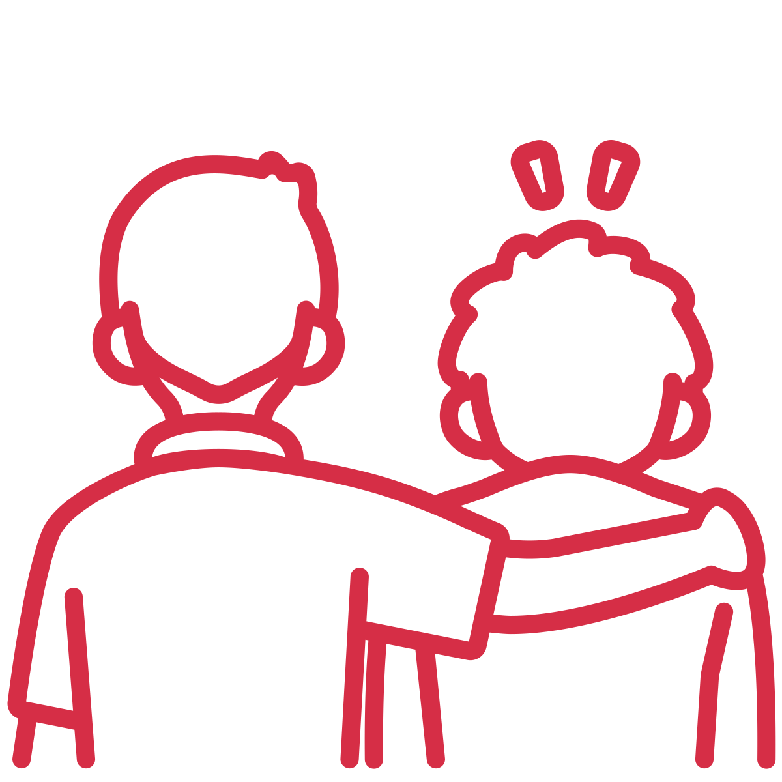
Strategies to Be an Ally
Notes:
For youth who are not in a position to directly defend someone, there are various other strategies they can engage in -all of which are helpful!
For example:
[CLICK] They can ask an adult to help. This is something that can be done privately and confidentially. It’s critical for educators to make it clear that if a student comes to you with a concern, you will take it seriously and address the situation without ‘outing’ the student who came to you. This will protect them from being retaliated against.
The youth can also [CLICK] comfort the person who was bullied. For example, they could ask if that person is ok, and communicate that they don’t agree with the bullying they saw.
Similarly, youth can connect with the person who was bullied. [CLICK] This might look like walking with them in the hallway, asking them to sit together at lunch, inviting them to join a club, or even starting a new club (for example, a Gay Straight Alliance).
As an educator, you can help youth figure out which strategy is best for them, and the specific way(s) they can be an ally. Being an ally means being a helper, and in this context, a helper who is looking out for people from marginalized groups specifically.
Facilitation guidance: See “Strategies to Help Students to Become Allies and Prevent Identity-Based Bullying” below (end of script) for various strategies you can use with your students.

Slide 22
1
Importance of identifying identity-based bullying.
2
Recognizing all identity-based bullying as harmful.
3
Encouraging students to feel
responsible.
4
Various barriers to intervening.
Summary
5
Various strategies for being an ally.
See “Strategies to Help Students to Become Allies and Prevent Identity-Based Bullying” for more
Notes:
So far, we’ve talked about:
[CLICK] How it’s important to be able to identify identity-based bullying and the various forms it can take
[CLICK] Recognizing all instances of identity-based bullying as harmful
[CLICK] Encouraging your students to feel a responsibility to do something when they see identity-based bullying
[CLICK] The various reasons that make it hard for students to intervene, and
[CLICK] Different ways for youth to act as allies, recognizing that not all youth are in a position to defend others directly
To help you and your students think of the various ways they can become allies to prevent identity-based bullying, [CLICK] see “Strategies to Help Students to Become Allies and Prevent Identity-Based Bullying ”.
Facilitation guidance: “Strategies to Help Students to Become Allies and Prevent Identity-Based Bullying” is below (end of script: https://www.prevnet.ca/sites/prevnet.ca/files/peers_as_allies_script_final.docx).

Slide 23
Thank you to partners and collaborators!
Financial contribution from Ontario Ministry of Education

